Slide 1
More Math Methods
Developed by Max Spero

Slide 2
Background
Max graduated from CV a bunch of years ago. When he did the CVMath assignment, he was inspired to try to use the idea to do his math analysis homework…And he did!

Slide 3
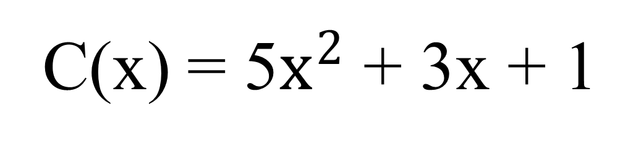
Background
For example, consider the following polynomial:

Slide 4
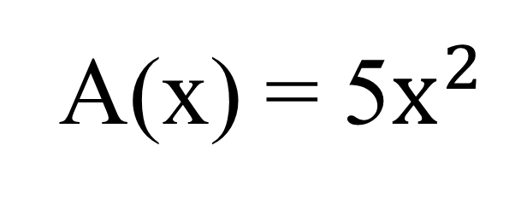
Background
Using Max’s code,
becomes
Xval A = new Xval(5,2);

Slide 5
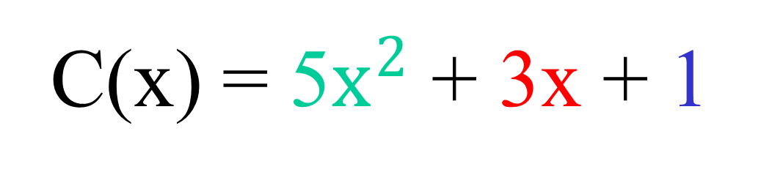
Background
And,
becomes
Polynomial c = new Polynomial(A, new XVal(3,1), new XVal(1,0));

Slide 6
Background
If we want to evaluate a polynomial,
C(2) = ?
in code…
System.out.print(c.valueAt(2));
// output is 27

Slide 7
Lab
Read Max’s REAME file
Try to do your math homework!

